Slide 1

Concur Travel & Expense System
Kickoff Meeting
May 12, 2022

Slide 2
Agenda
Project Introduction
Project Scope
Remarks from Executive Sponsors
Project Timeline
Project Team
Changes Impacting Employees (End Users)
Changes Affecting UMB

Slide 3

Concur Travel & Expense System
Why the Change
What’s Changing
What’s the Scope

Slide 4

Reasons and Rationale for Why the Change
Safety & Security Systems update demands
Legacy travel system based on outdated technology
Current Cloud solutions enhancement upgrades
Time saving process improvements

Slide 5

What’s Changing - Areas of Enhancement
Integrated Travel Booking
Multi-Level Workflow and approvals
Integrated Duty of Care management
Robust Reporting and analytics tool in real time
Mobile Travel application

Slide 6
Scope of the Project
Implement
Implement a modern, SaaS-based T&E solution that is best in class.
Increase
Increase the efficiency of UMB T&E processes through automation and configurable workflow.
Increase
Increase the access to and ability to use travel data and related financial data to make business decisions.
Increase
Increase transparency and compliance on travel and business expense spending to demonstrate responsible stewardship of resources from state, federal and private funders.
Provide
Provide tools to travelers from booking to reimbursement that is flexible yet allows UMB to protect travelers.

Slide 7
Scope of the Project
Reduce
Reduce UMB stakeholder reliance on supplementary systems to support their reporting.
Reduce
Reduce the effort, cost, and time to apply patches and upgrades that deliver new functionality.
Adopt
Adopt a flexible technology platform with a high degree of usability.
Adopt
Adopt a technology that provides users with the flexibility to access the system and accomplish work tasks via mobile platforms.

Slide 8
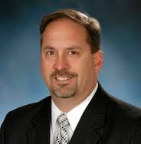
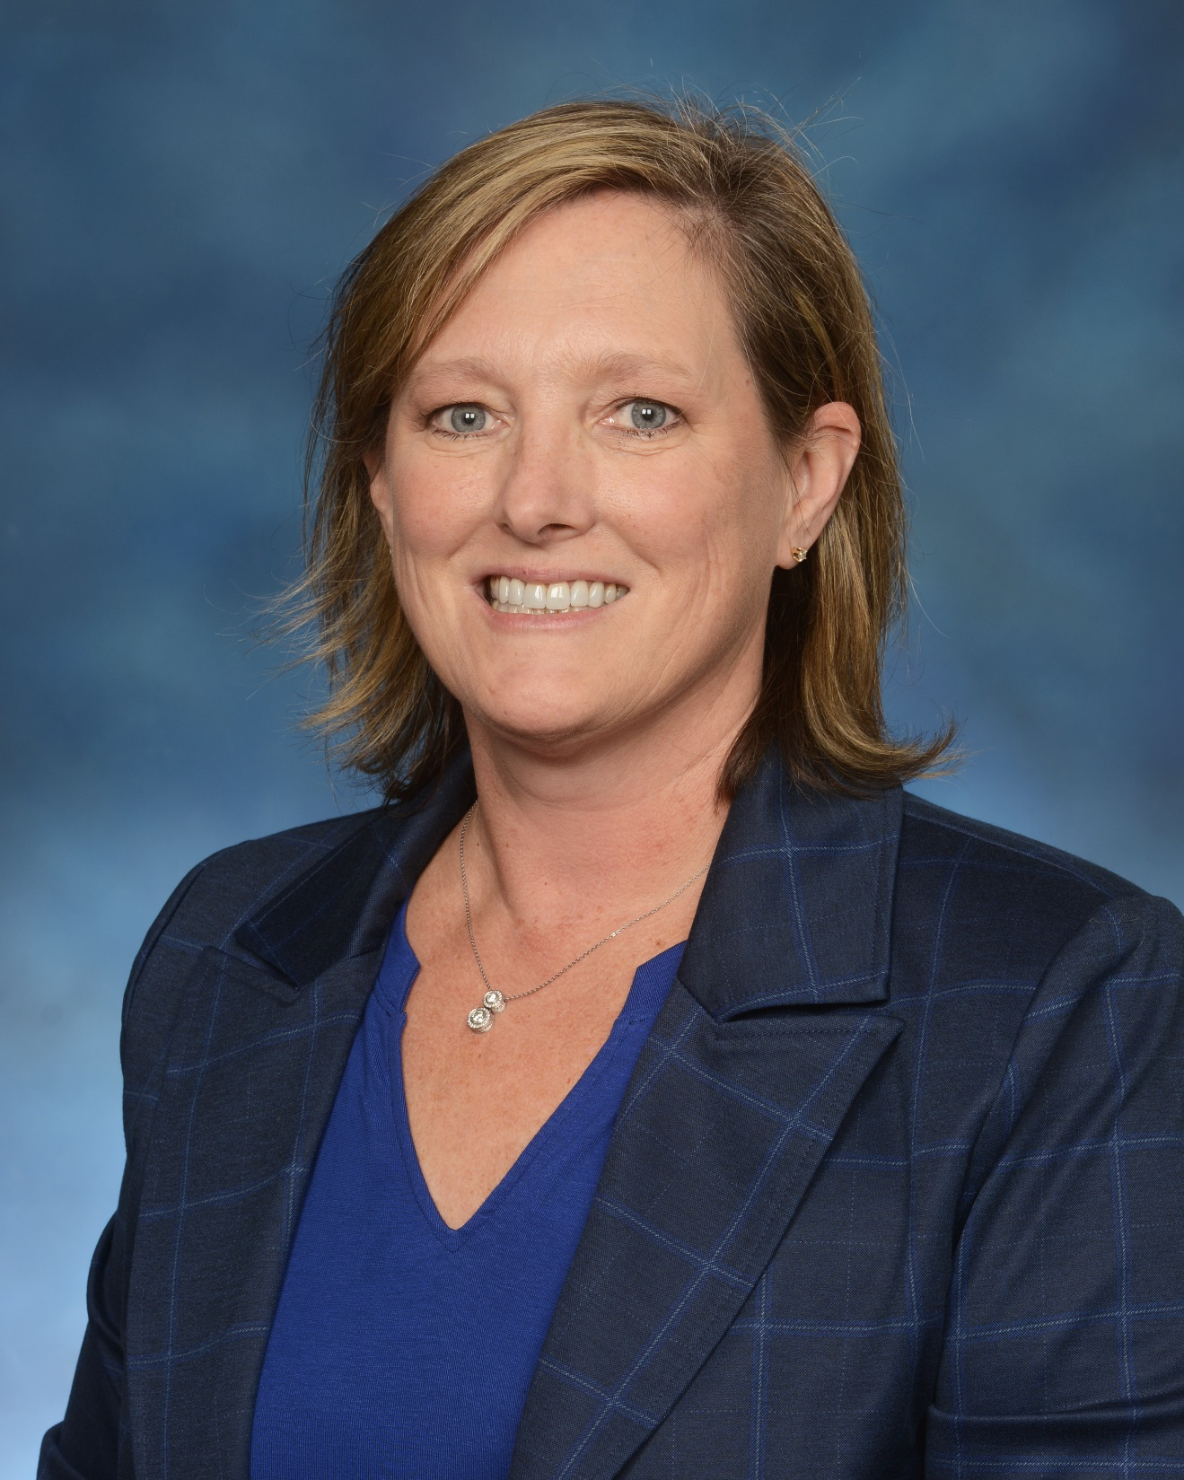
Executive Sponsors
Scott Bitner, Vice President for Finance and Auxiliary Services and Deputy Chief Financial Officer
Diane Faranetta, Associate Vice President, Enterprise Applications

Slide 9

Four Phase Project Approach
Phase 1
Project Planning
Jan – April 2022
Phase 2
Preparation & Design
April – September 2022
Project Timeline
Phase 3
Testing and Implementation
June – Fall 2022
Phase 4
Go Live and Stabilization
Fall 2022

Slide 10
Project Managers
Luke Quell
Acting Director, Business Applications
Lakshmi Kinnera
Applications Development Manager, Integrations

Slide 11
Change Management
Michele Evans
Executive Director, Change Management and Advisory Services
Beth Gallico
Business and Quality Improvement Analyst, Change Management and Advisory Services

Slide 12
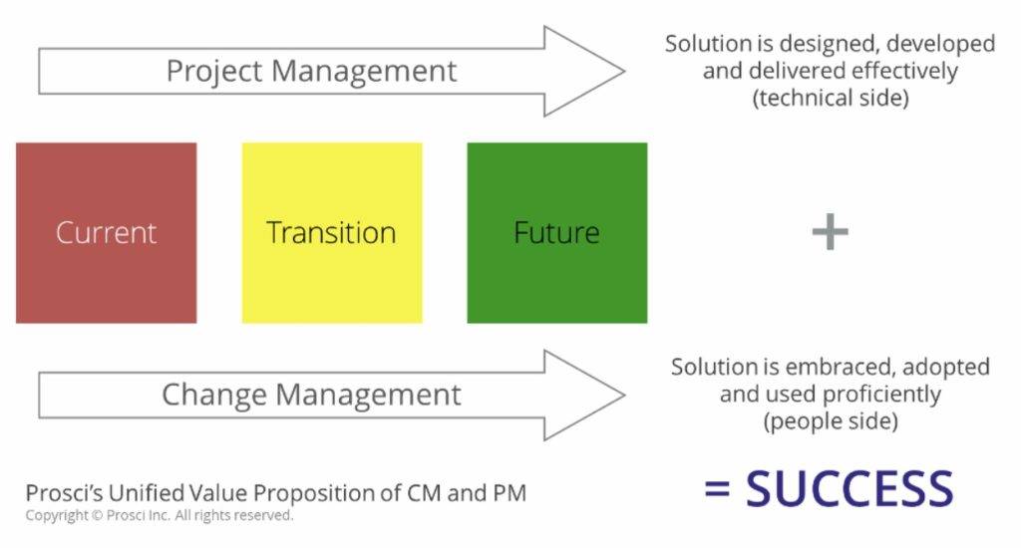
Project Management and Change Management
Change Management in collaboration with Project Management focus on End Users
PM & CM run parallel through the project
Working together helps guide how we prepare, equip, and support end users
Focus is on enabling end users to adopt, stay engaged, feel heard & supported
Managing change thru communications, training, knowledge sharing and educational workshops, and surveys to measure success
Notes:
Michele and Beth will cover this slide.
Project Management and Change Management run in parallel throughout the project.
Working in collaboration with project management, helps guide how we prepare, equip, and support individuals to successfully adopt change to drive Organizational success and outcomes.
Project management is focused on effectively designing, developing, and delivering a technically accurate product on budget and within scope.
Change management is focused on making sure employees will be able to embrace change, adopt to change faster, stay engaged, and understand why the change is happening.
Change Management manages change through communications, training, knowledge sharing and educational workshops, surveys and focus groups to measure end user success
Both PM & CM in coordination with active and visible sponsors, work together for the success of the project by preparing , managing and reinforcing change.
All employees will experience change with the implementation of a new Concur Travel & Expense System. Our goal is to support all users (department and central office) to successfully get through the transition by staying connected with changes & improvements, share best practices, have a voice and be supported.

Slide 13
Campus Advisory Council
Cindy Lyons
Chair
OOTC
Michele Evans
Lead
CMAS
Beth Gallico
CMAS
Herty Cortez Diaz
IOS
Virginia Rowthorn
CGE
Teri Caughman
SON
Bill Cooper
SOP
Raymond Dudeck
OAA
Andreas Ortmeyer
SOL
Flavius Lilly
Grad School
Reetta Gach
EDI
Valerie Sikora
SOD
John Yurich
CASS
Louisa Peartree
SOM
Cheryl Fuller
SSW
Jane Allgair
ORD-E&ED

Slide 14

Project Org Structure
Executive Sponsors
Campus Advisory Council
Project Managers
Functional Leads
Technical Lead
Change Management
Request
Travel
Expense
Mobile Apps
Reporting
Integrations
Directory Management
SSO
Security
TMC
Audit
Duty of Care
Compliance
Reporting
Training
Testing

Slide 15
Concur Team Members
Campus Advisory Council
Project Management & Change Management
CITS Technical Team
School/Department SMEs
Central Office Functional Team
Executive Sponsors

Slide 16
Central Offices Functional Team
Deputy Controller TBD
OOTC
Lynell Griffin
OOTC
India Taylor
OOTC
Kerri Williams-Tong
OOTC
Laura Pogliano
BA
Training
Willa Fan
BA
Analysis
Debbie Tatum
OOTC
Libre' McAdory
BA
Reporting
Susan McKechnie
Lead
John Jensen
Lead
Jennifer Thompson
MAS

Slide 17
CITS Technical Leads
Lakshmi Kinnera
Technical Project Manager
Nagaraju Daramukkala
Integration Lead
Laura Broy
Testing Lead
June Doerr
Security Lead

Slide 18
Schools/ Departments, Business Unit SME’s
International Travel Specialist - IOS
Raymond Dudeck - OAA
Dean Glorioso - SOL
Cheryl Fuller - SSW
Bonnie Bissonette - CGE
Shauna Guest - SOP
Kelli Sattler - SOM
John Yurich - CASS

Slide 19
Changes Impacting employees (end users)
Impact of the change on employees
What we know now
When will more info be available
Support, Training, Assistance
Employee feedback about the change

Slide 20
Changes Impacting employees (end users)
Impact of the change on employees
Reduce the time spent making travel reservations
Minimize the hassle of getting reimbursed for expenses
Allow on-the-go capabilities through user friendly mobile applications
Provide pre-populated expense reports
Offer a simplified experience to be in compliance with UMB policies and procedures
What we know now
SAP Concur is used by over 650 Colleges & Universities
UMB will be deploying the Request and Expense products
UMB will be integrating the Travel Booking with Travel Leaders Corp (travel agency)
UMB will be integrating with International SOS (duty of care services)
Some aspects of the current policy and procedures will change

Slide 21
Changes Impacting employees (end users) -Continued
Support, Training, Assistance
All training will be on-line
The UMB help desk management system will be used
A Concur help tool will be utilized
When will more info be available
Communication via the Elm and Quantum Bytes
Virtual town halls in July and November
Updates at Travel Admin Group meetings
Employee feedback about the change
Surveys and assessments
Analytics on use
Feedback from Travel Admin Group on their experience

Slide 22
Changes Affecting UMB
Organization vision after the change takes place
Scope of the change
Objectives for change (what does success look like)
Business Process changes – Alignment of the change with business strategy

Slide 23
Changes Affecting UMB - continued
Objectives for change (what does success look like)
Better compliance with USM policy
Better analytics for travel spend
Improved employee experience- satisfaction and productivity
Safeguard our data with modern technology
Business Process changes – Alignment of the change with business strategy
Requirements for use of Concur travel booking?
Consequences for not doing a Request before the travel?
Reduce approvals on Request?

Slide 24
Changes Affecting UMB
UMB vision after the change takes place
Drive travel and expense policy compliance
Gain better visibility to travel and expense spending
Unify the travel and expense process
Eliminate the need to collect, manage and store paper receipts
Leverage our buying power with vendors
Fulfill our duty of care responsibilities efficiently and effectively
Scope of the change
Pre-authorization request
Travel booking
Duty of Care compliance for international travel
Expense reimbursements

Slide 25

Questions

