Slide 1
Continuing Our Conversation About Race
July 28, 2015

Slide 2
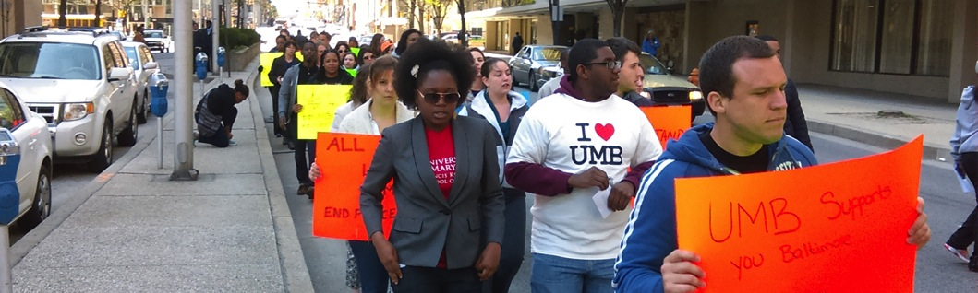

Slide 3
Diversity Advisory Council
The Diversity Advisory Council makes recommendations to the president that promote the University’s commitment to diversity and a culture of inclusion. The council enhances the environment to ensure that diversity is valued and that inclusion is a guiding principle in every aspect of the University’s activities.
Chair Elsie Stines, DNP, MS, CRNP
Vice Chair Vanessa Fahie, PhD, RN
Ex officio Roger Ward, EdD, JD, MPA

Slide 4
Conversation Themes
Career and Professional Advancement
Cultural Competency
Community Service and Engagement

Slide 5
Career and Professional Advancement
Are underrepresented minorities—in particular African Americans—routinely passed over for promotions and other advancement opportunities?
Does the University lack clear career pathways—particularly at lower paid positions—that would provide underrepresented minorities opportunities to advance their careers at the University?
Is there a lack of underrepresented minorities in leadership and supervisory positions at most levels of the University?

Slide 6

Cultural Competency
Do faculty, staff, and students lack the cultural competency necessary to effectively engage, interact with, and serve the members of Baltimore’s diverse communities?

Slide 7
Community Service and Engagement
Are students inadequately prepared by the University to work with and within Baltimore’s underserved communities?
Are service projects and experiences developed without sufficient input from Baltimore’s communities—resulting in projects and experiences that are not always impactful, meaningful, and valued by the community?
Does the debt burden with which UMB students graduate act as a barrier to pursuing lower paying career opportunities in urban and underserved communities?

Slide 8
Career and Professional Advancement: Recommendations
Conduct a comprehensive analysis of the University’s personnel actions relating to recruitment, promotion, tenure, reclassifications, and equity adjustments.
Enhance the University’s efforts to promote a culture of diversity and inclusion—particularly in its workforce—as prescribed by the 2011–2016 Strategic Plan.
Evaluate the University’s job classification system and, where necessary, modify the system to create a clearly defined career advancement pathway and career development opportunities for each position.

Slide 9
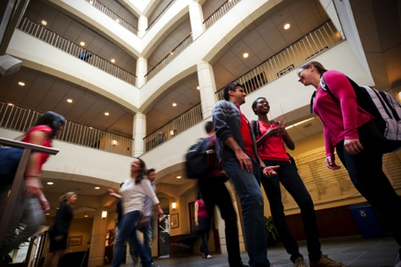
Cultural Competency: Recommendations
Draft and adopt a Statement on Cultural Competency that clearly defines “cultural competency” for the University community. The statement should form the foundation for the cultural competency initiative prescribed by the 2011‒2016 Strategic Plan.

Slide 10
Cultural Competency: Recommendations
Evaluate strategies for enhancing cultural competency at the University, including:
Encouraging UMB’s schools to enhance cultural competency within their curricula and making available to faculty, staff, and students resources that advance that goal.
Partnering with the University of Maryland Medical Center to promote cultural competency across both organizations.
c. Engaging the University community in a dialogue about the cultural competency research and recommendations to be undertaken by the President’s Fellows in 2015‒16.

Slide 11
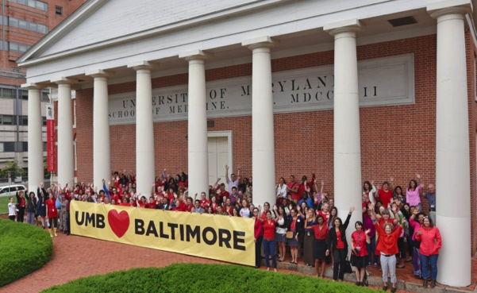
Community Service and Engagement: Recommendations
Support the newly formed Office of Community Engagement in the Office of the President in building a comprehensive and coordinated community engagement strategy for the University.

Slide 12
Community Service and Engagement: Recommendations
Prioritize key components of this strategy, including:
Orientations and professional development in community service and engagement.
A University “day of service.”
An effort to enhance UMB’s presence in, and partnership with, the communities immediately adjacent to campus.
d. A career program that educates community residents about employment opportunities at the University.

Slide 13

Career and Professional Advancement: Recommendations
Conduct a comprehensive analysis of personnel actions
Human Resource Services (HRS) has begun a comprehensive review of the University’s personnel actions relating to recruitment, promotion, tenure, reclassifications, and equity adjustments over the past three fiscal years. The analysis
will be conducted at both the University and school levels; include both faculty and staff; and examine these personnel actions with regard to race/ethnicity and gender.

Slide 14
Career and Professional Advancement: Recommendations
Evaluate UMB’s job classification system
HRS will recommend to UMB senior leadership a new job classification system with a clearly defined career advancement pathway and career development opportunities for each position.
Promote a culture of diversity and inclusion
In accordance with the 2011–2016 Strategic Plan, the Diversity Advisory Council (DAC) and HRS will engage an external consultant to conduct an institution-wide climate survey to assess perceptions of diversity and inclusion among students, faculty, and staff.

Slide 15
Cultural Competency: Recommendations
Adopt a “Statement on Cultural Competency”
DAC will draft a cultural competency value proposition and present it to UMB senior leadership for consideration.
Evaluate strategies for enhancing cultural competency
As part of the 2015‒16 President’s Symposium and Whitepaper Project, the President’s Fellows will engage the campus community in dialogue and scholarship on cultural competency as it relates to our work in law, health, and human services and provide UMB senior leadership recommendations on how to better prepare culturally competent professionals.

Slide 16

Cultural Competency: Recommendations
Evaluate strategies for enhancing cultural competency
Drawing on its own work and on the recommendations of the President’s Fellows, DAC will propose to UMB senior leadership a framework to guide the University’s effort in promoting cultural competency as an essential attribute in the ongoing growth and development of faculty,
staff, and students.

Slide 17
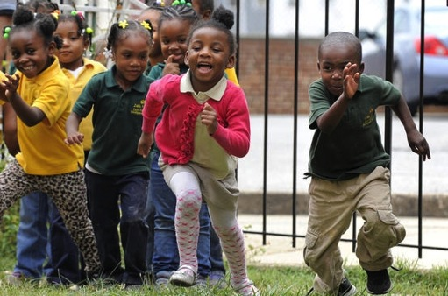
Community Service and Engagement: Recommendations
Prioritize key components of a comprehensive, coordinated community engagement strategy
DAC recommends that the University, through the Office of Community Engagement, design and implement community service and engagement orientations and
professional development opportunities for faculty, staff, and students.

Slide 18
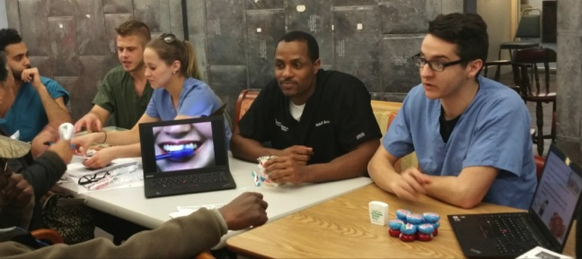
Community Service and Engagement: Recommendations
Prioritize key components of a comprehensive, coordinated community engagement strategy
DAC recommends that the University pilot a Day of Service, modeled after UMB’s annual Interprofessional Education Day.

Slide 19
Community Service and Engagement: Recommendations
Prioritize key components of a comprehensive, coordinated community engagement strategy
In FY 2016, the University will establish an Extension Center that enhances UMB’s presence in, and engagement with, the West Baltimore communities closest to campus.
DAC recommends that HRS pilot an Employment Readiness Program that educates community residents about job opportunities at the University and prepares them to be competitive applicants for open positions.

Slide 20

Community Service and Engagement: Recommendations
Prioritize key components of a comprehensive, coordinated community engagement strategy
DAC recommends that the University establish a task force to evaluate: (a) the impact of UMB’s increasing cost of attendance on access to, and affordability of, academic programs; and (b) whether the debt burden with which UMB students
graduate acts as a barrier to pursuing lower paying career opportunities in urban and underserved communities.

Slide 21
Diversity Advisory Council
The Diversity Advisory Council enhances the environment to ensure that diversity is valued and that inclusion is a guiding principle in every aspect of the University’s activities.
www.umaryland.edu/president/diversity-advisory-council

Slide 22
Continuing Our Conversation About Race
July 28, 2015

